Slide 1



YOUR COMFORT IS OUR BUSINESS
Presented By :
Mayur Kanojiya (120770107086)
Ronak Janani (120770107061)
Datt Patel (120770107056)
Guided By :
Ms. Snehi Patel

Slide 2
OUTLINE
Login
Admin Panel Login
User Panel Login
Meeting Manager
Expense Manager
Forum
Website Manager
Resident Manager
E-Voting
VR Map
Push Notification
Conclusion
Task Manager
Payment Gateway

Slide 3
Detailed Description of Definitions
In this project we are going to develop the java based software which involves management of a society. We will develop the web portal for this Society management and an android application for notifications.
There are mainly three modules Management, Forum, Notifications and Society Bank.
In this portal, the chairman suggests the residents for completing such tasks. This task involves management of society from different areas of interest. And management orders the members of society for doing that task.

Slide 4
Detailed Description of Definitions
It includes various functionalities such as perfect UI interactions, complain box, notification box. At last user can suggest or give complains or give thanks to management according to their requirements.
There is such functionality like notifications, security, VR map integration etc.

Slide 5
Objective
The problems of society can be reduced by using this system. It will be beneficial to citizens because they can communicate to the chairman through this portal.
The task of chairman becomes easy by using this portal because they can manage in proper manner.

Slide 6
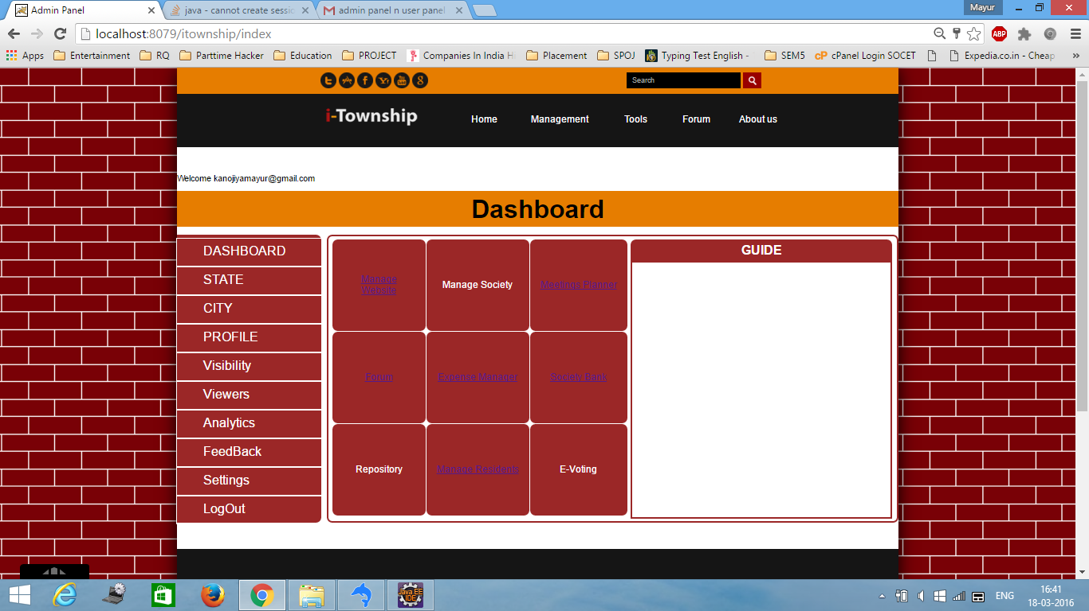
Admin Panel Login

Slide 7
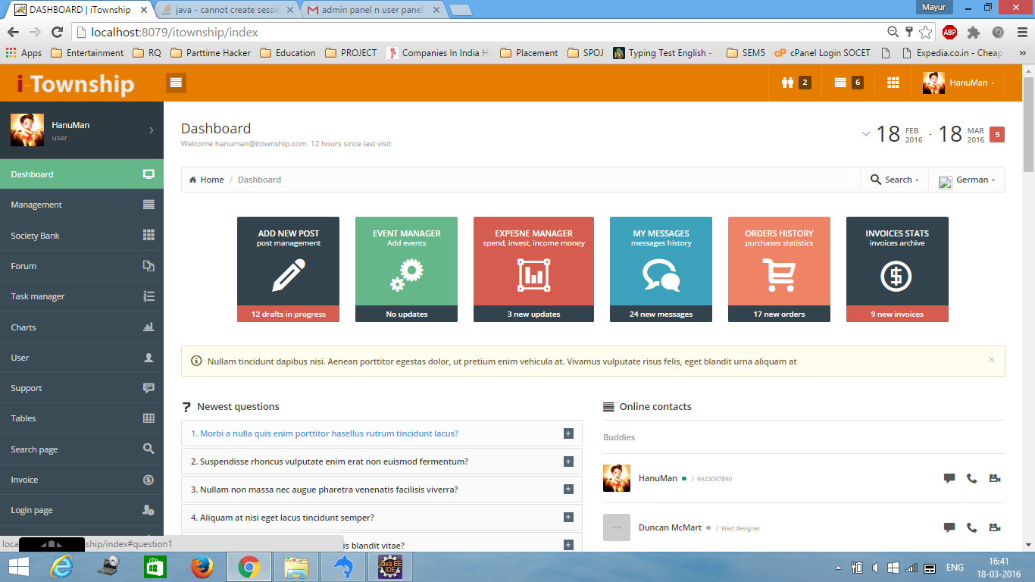
User Panel Login

Slide 8
Meeting Manager
Features
Manager roles can be created for Office Staff.
Discuss Facility Management Issues and other Improvement Areas within the Admin Team.
Close the Meeting and share the Report by Email to all Invitees.
Quickly Create Recurring Tasks and monitor tasks and assign them.

Slide 9
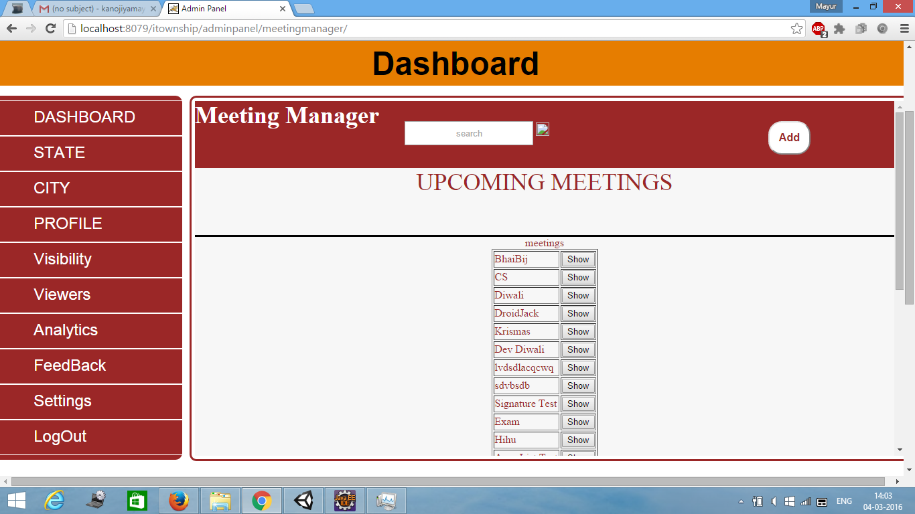
…Continue

Slide 10
Expense Manager
Features
Residents can pay their dues online through Payment Gateway provided by PayU.
Instant E-Receipts is generated and their Dues get cleared off.
Facility Booking, Move in/out charges, Festival ticketing can all be done easily through Payment Gateway.
Verify if all documents have been submitted by member and generate defaulters report.

Slide 11
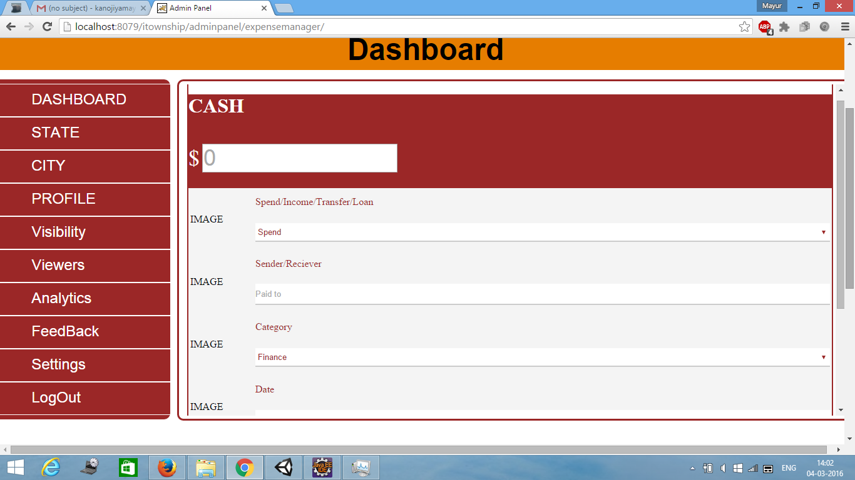
…Continue

Slide 12
Forum
Features
Discuss Facility Management Issues and other Improvement Areas within the Admin Team.
Can control instant email notification, receive and reply to and from email.
Admin Forum is available only to the Admin Team.
Same features as that of the Resident Forum.

Slide 13
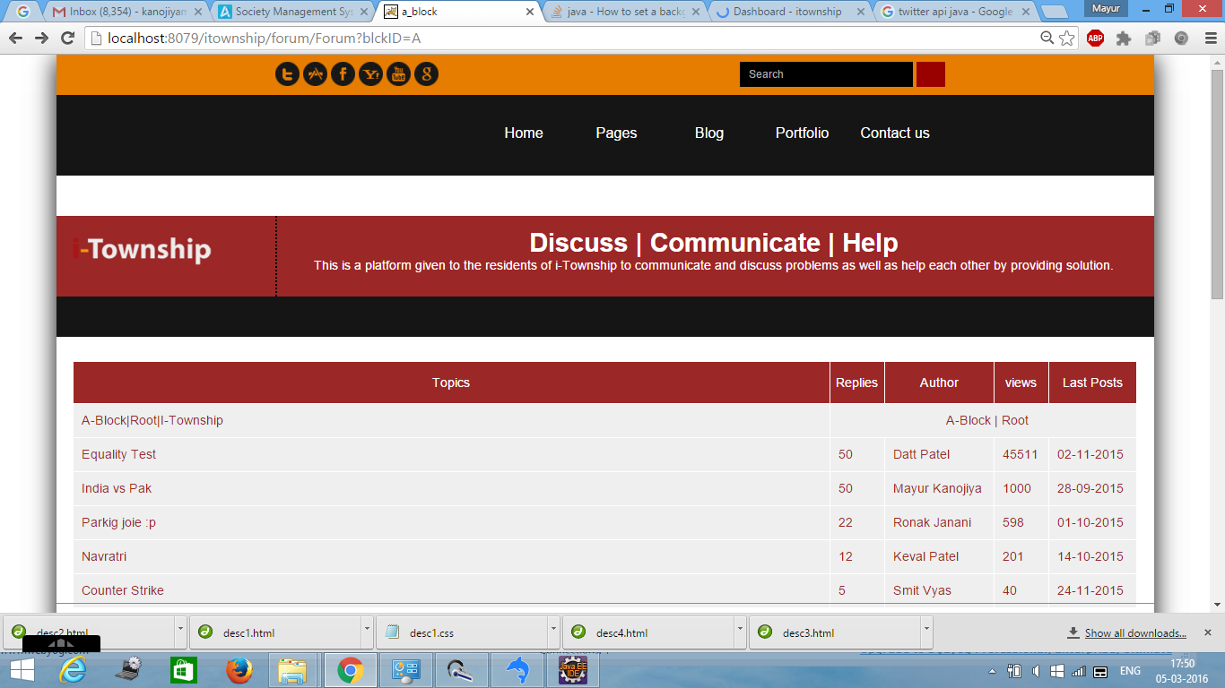
…Continue

Slide 14
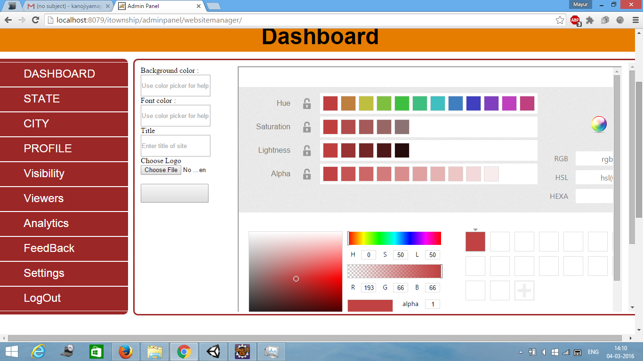
Website Manager

Slide 15
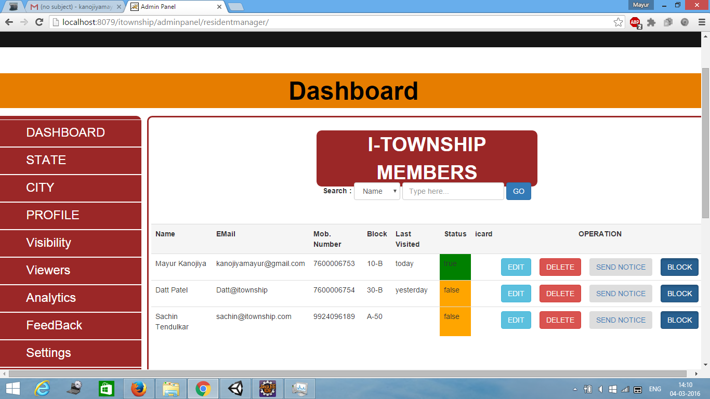
Resident Manager

Slide 16
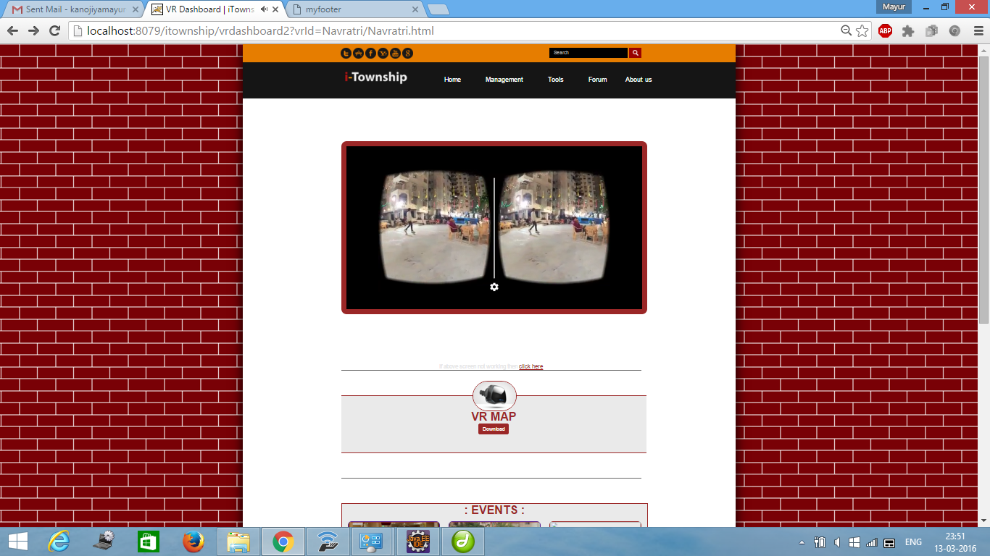
VR Map

Slide 17
Push Notification
Features
You can send push notifications to all major mobile platforms. However, not all features are supported on all platforms.
When used correctly push notifications represent a great channel by which to deliver meaningful content to your existing app users whenever you like.
Optimising your targeted push messages is about understanding customer behaviour.

Slide 18
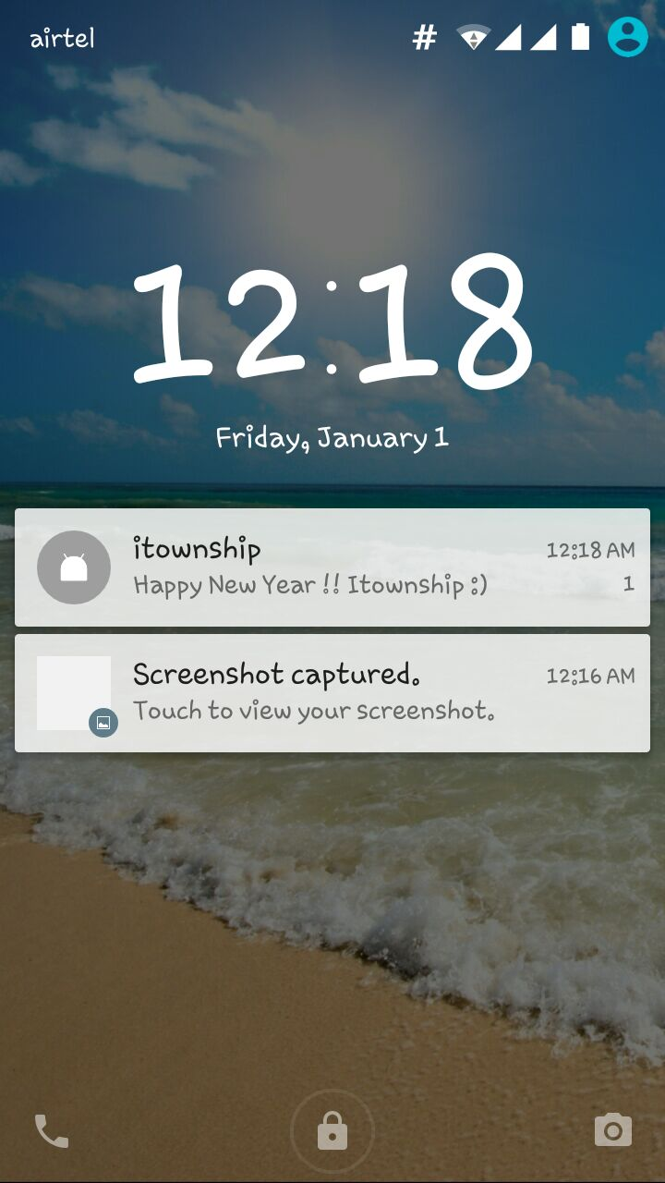
...Continue

Slide 19
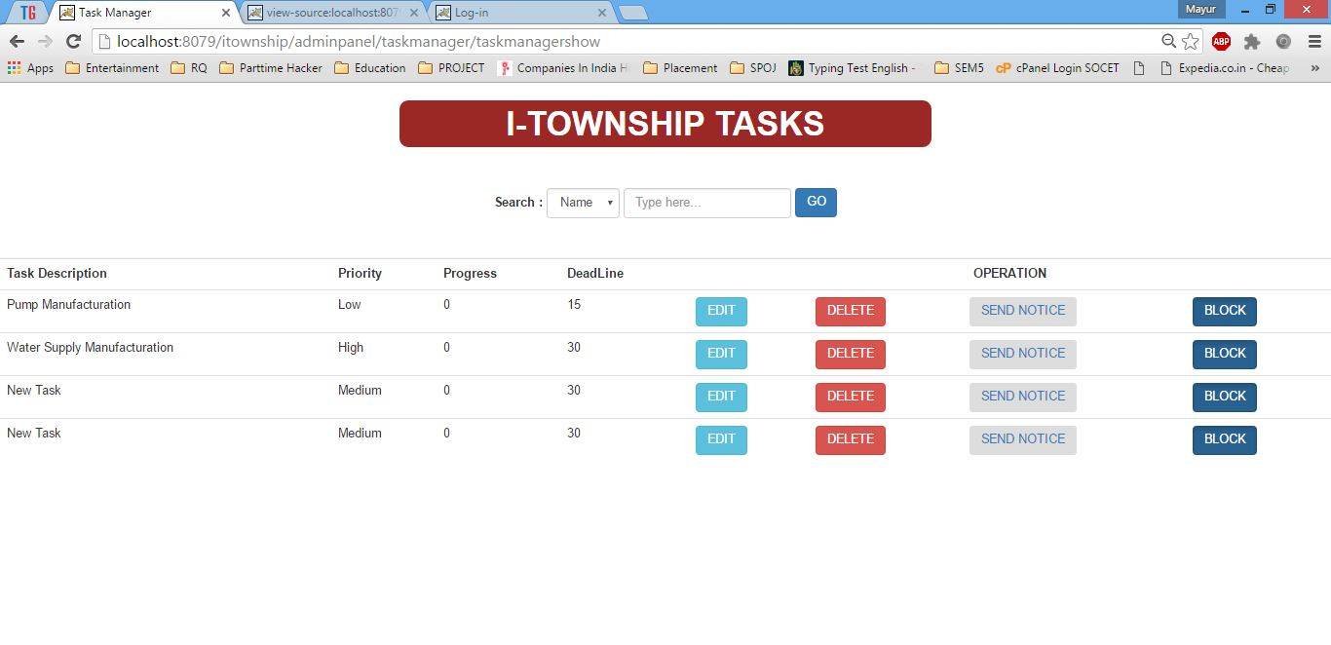
Task Manager

Slide 20
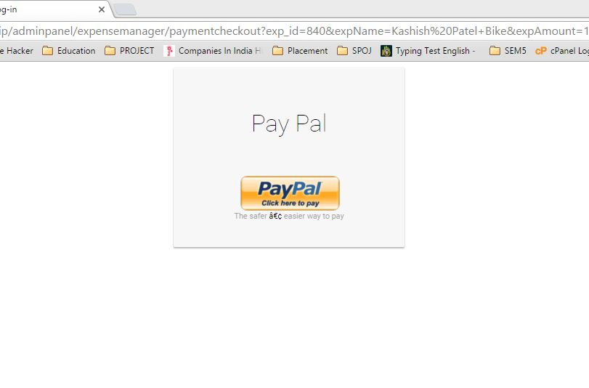
Payment Gateway

Slide 21
Conclusion
To improve Society management & Security.
To help Civilians of the Society.
For online Meeting & Maintenance.
Saving of time of Civilians.
Better Way to Communicate & Interaction.

Slide 22


